Slide 1



TEAM NAME:
My ML

Slide 2
Problem Statement
ServiceNow Optimization by categorization of tickets by analyzing ticket description using NLP

Slide 3
Describe your solution
We looked at different algorithms to automatically classify support tickets into different tiers of Urgency. We found that Support Vector Machines work better out of the box, but Decision Trees gave us more insight into how the model worked.
we created a vectorizer and a classifier. Then we call fit_transform on X_train. This calculates an efficient numerical value for each word in our training set and transforms our it into sparse Bag of Words vectors, in which each text is represented by counting how often each word appears. We used the same vectorizer to transform our test set into vectors, train our classifier, and predict results on our test set.
Technology Stack used
IBM Watson studio
Python
Jupyter Notebook
Scikit-learn, Pandas, NumPy, Matplotlib
Stochastic Gradient Descent

Slide 4
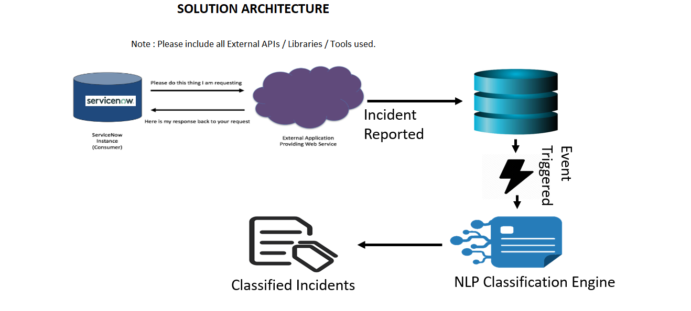
Solution Architecture

Slide 5
Use Cases & Business Value of the solution
This project addresses a real-life business challenge of IT Service Management. This is one of the known challenges in IT industry where a lot of time is wasted in IT support ticket classification.
In Helpdesk, almost 30–40% of incident tickets are not routed to the correct team and the ticket keeps ping-ponging from one team to another team, and due to this many ticket don’t meet the SLA which impacts the overall KPI.

Slide 6
What was accomplished
We created a classification model which predicts category by analyzing the text of ticket description. It will help to route the ticket to correct resolver group.
NLP was done using Count Vectorizer and TF IDF Vectorizer. Count Vectorizer tokenizes the text, removes stop words. TF IDF Vectorizer measures how frequently word appears in text and how important term is.
We trained model on 6 different classification algorithms – Gaussian Multinomial, Support Vector Machine, Decision Tree, Random Forest, Stochastic Gradient Descent and K-Nearest Neighbor. Based on training time and accuracy, we selected Stochastic Gradient Descent (SGD) for classification.
Accuracy of SGD is 84% and training time is 2 Seconds for 50k tickets.

Slide 7
Salient features of the solution
We created a classification model which predicts category by analyzing the text of ticket description. It will help to route the ticket to correct resolver group.
Accuracy of SGD is 84% and training time is 2 Seconds for 50k tickets.

Slide 8
Challenges & Learnings
Challenges :
for any machine learning model collecting the appropriate data is a big challenge, based on the available dataset we need to take a decision which ML algo fits in to get the maximum accuracy.
Applying the right ML methods, choose proper parameters to tune the algorithms, and adopting right strategies was also challenging.
As we were not familiar with IBM cloud, it was a challenging to use it for the first time.
Learnings :
We have got the opportunity to learn IBM cloud for Machine Learning.
We have learnt some new concept of NLP while creating a model for hackathon.
While preparing ML model for hackathon we came across multiple use cases of python library and machine learning concepts.

Slide 9
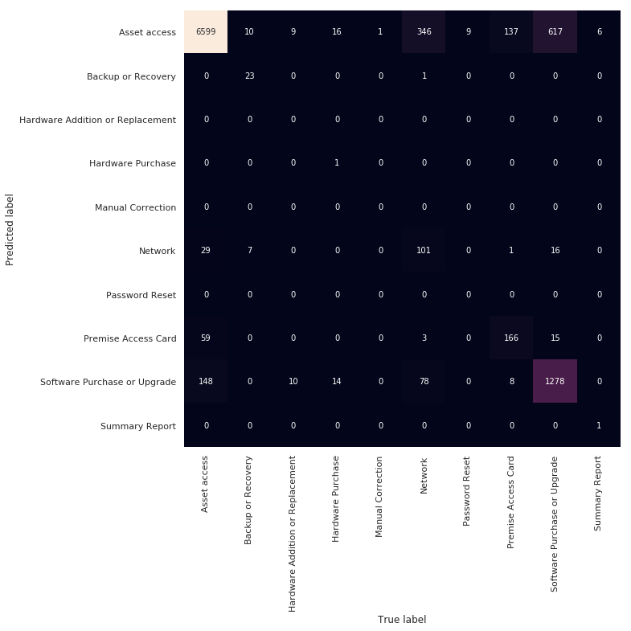
Screenshots (Confusion Matrix Heatmap)

